Slide 1
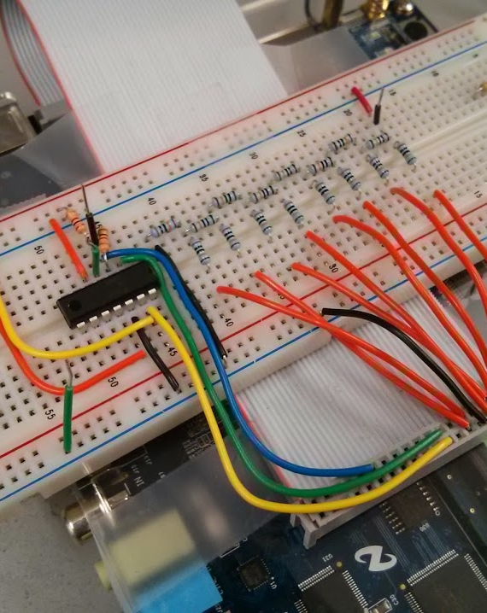
PROJECT PORTFOLIO
By Emmanuel Augustine

Slide 2
Table of Contents
Indoor positioning System (Prototype)
Self-Powered AM Radio
Electromagnetic Tether Car
Reflow Soldering Oven
Thermometer

Slide 3
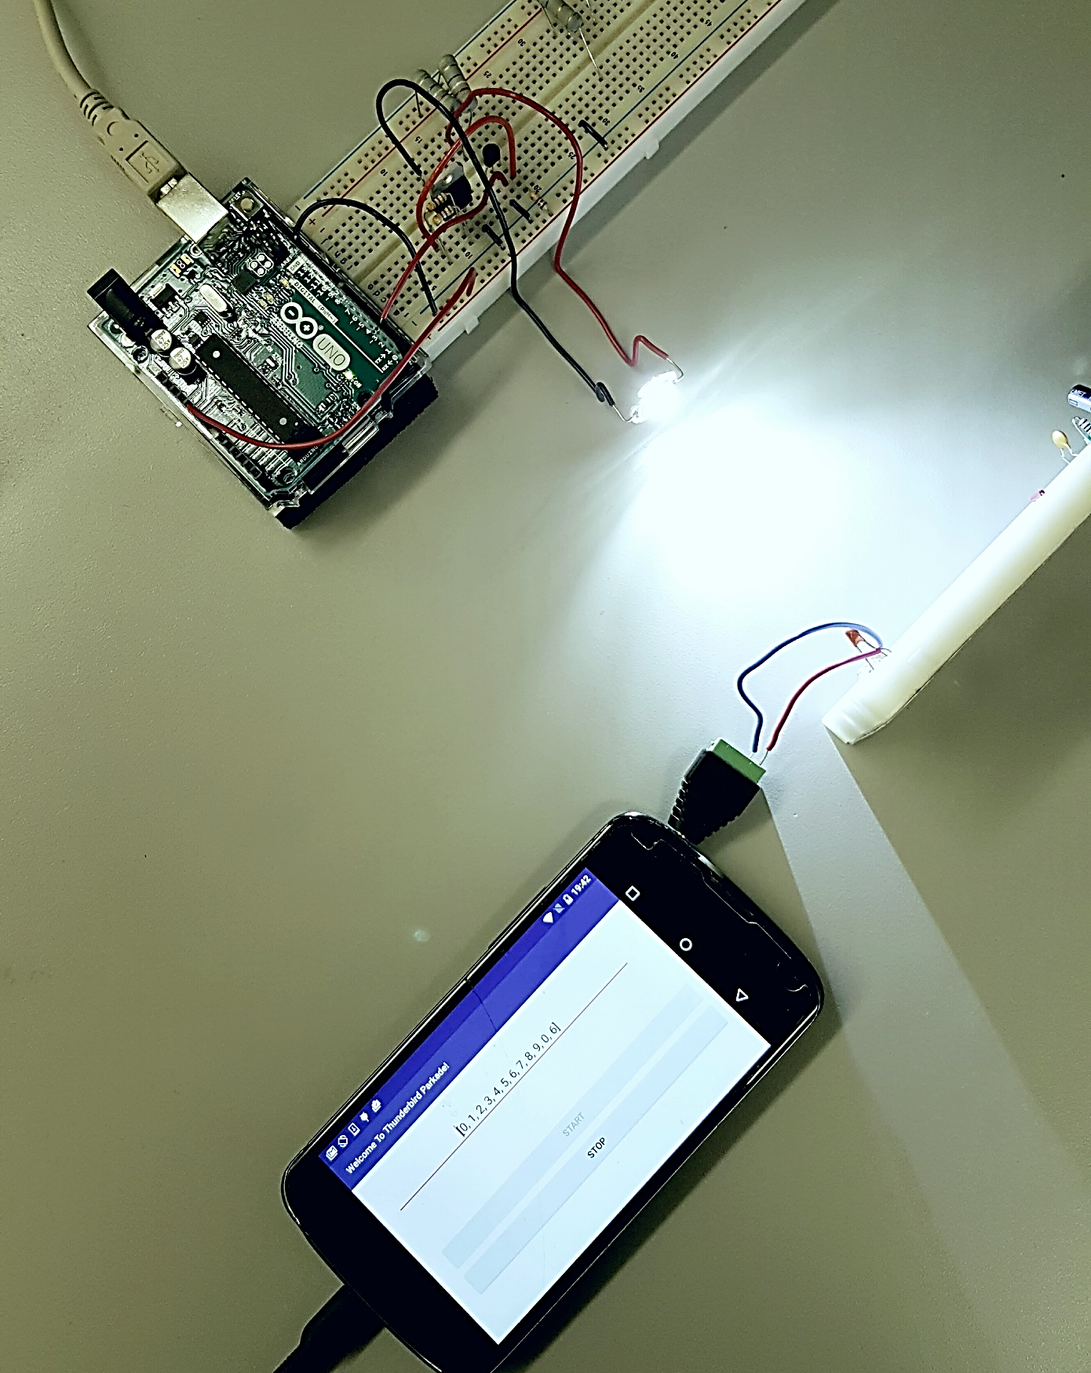
Indoor Positioning
A light is assigned a number and continually transmits that number when it is powered on. This number represents it’s physical location in a predetermined space. When the phone receives this number, the phone recognizes the location associated with this number and updates it’s location on an offline map to correspond to the received location.
Disclaimer: Image is of a prototype.

Slide 4



Indoor Positioning System - High Level Design
Step 1 Encode
Step 2 Transmit
Step 3 Receive
Step 4 Decode and Display
11011000100
Encode position information to Manchester code | Modulate High Power LEDs with MOSFETs | Receive with PIN Photodiode via headphone jack | Detect and decode the Manchester coded bits and display position

Slide 5
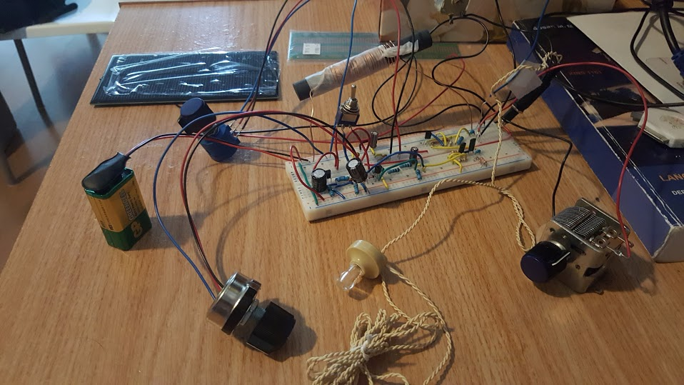
Self-Powered AM Radio
Solar Panel
(Charging/
Power)
High/Low Impedance
Amp Switch for earphones
Fine Tuning
Dial
Rechargeable
Battery
High Impedance
Earphone
Tuning Dial

Slide 6
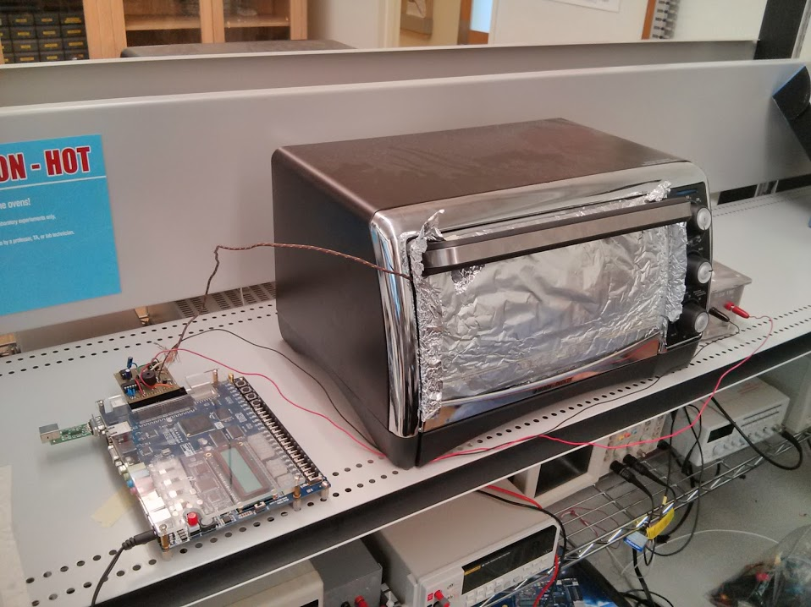
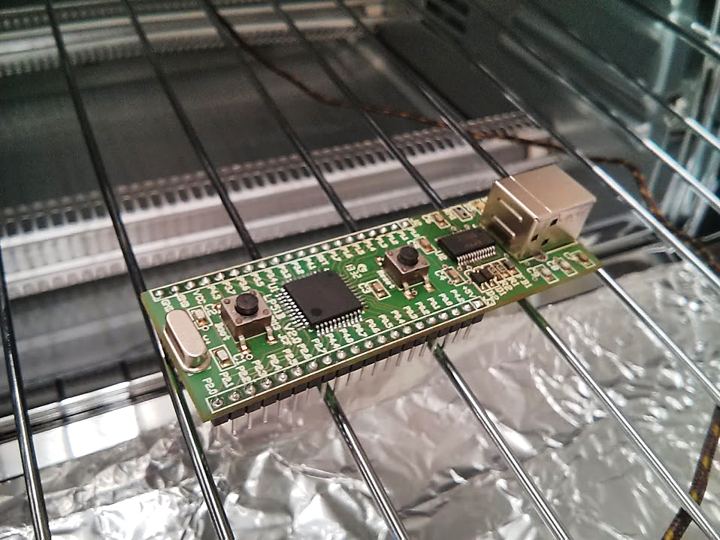
Reflow Soldering Oven
FPGA used to monitor and control oven temperature using PWM
LP51B – Atmel microcontroller after successful soldering in the oven.

Slide 7
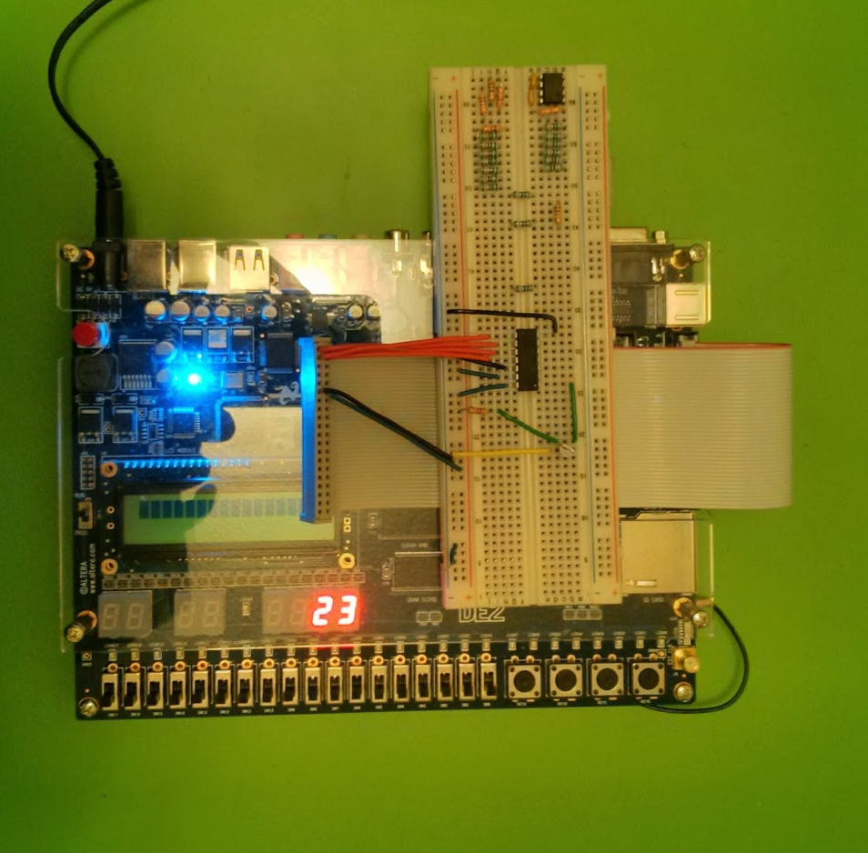
Thermometer
Created using an LM335 Temperature Sensor
Connected to Altera DE2 FPGA via ADC
Current image displays the operation of the thermometer in room temperature conditions

Slide 8
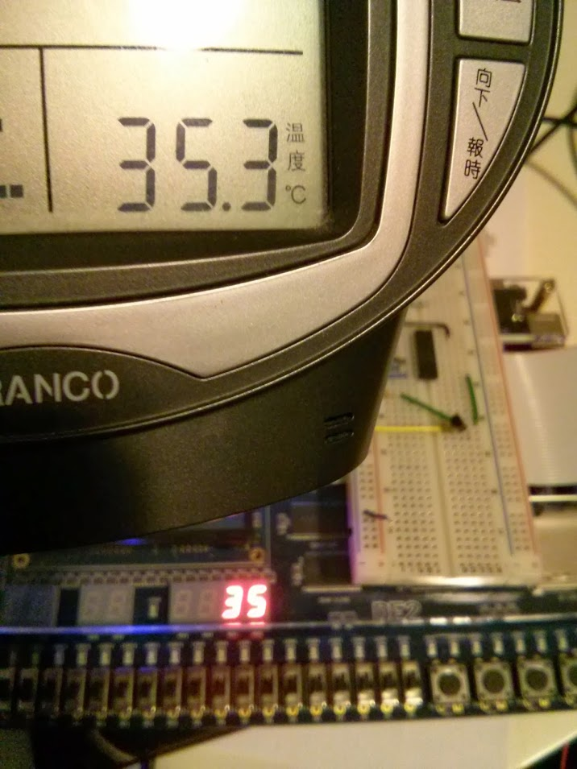
Testing Thermometer
Testing accuracy in hot weather. Heat is simulated by a room heater in close proximity to the sensor

Slide 14
Title and Content Layout with List
Add your first bullet point here
Add your second bullet point here
Add your third bullet point here

Slide 15
Title and Content Layout with Chart

Slide 16
Two Content Layout with Table
First bullet point here
Second bullet point here
Third bullet point here
 | Group A | Group B
Class 1 | 82 | 95
Class 2 | 76 | 88
Class 3 | 84 | 90

Slide 17
Title and Content Layout with SmartArt
Step 1 Title
Step 2 Title
Step 3 Title
Step 4 Title

